Slide 1


Delta Updates
OGC API - Features
OGC API - Process
Client

Slide 2
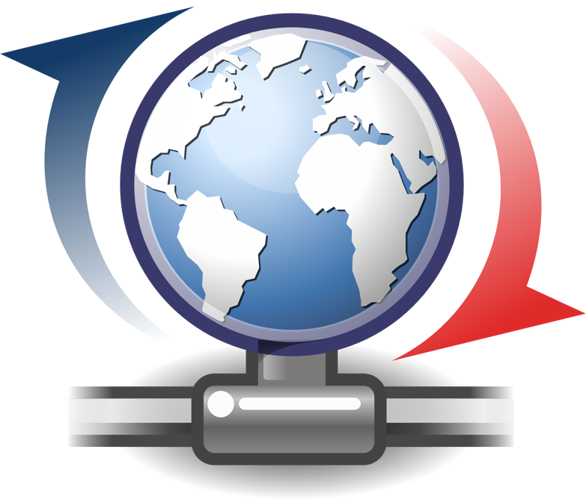
Delta Updates
Retrieval of updates with priority flags

Slide 3
Goal
Delivery of prioritized updates of features
Two scenarios:
Web Feature Service (WFS) instances to support updates on features sets
Web Processing Service (WPS) instance to access features, without the need to modify the downstream data service
Both scenarios to use OGC APIs

Slide 4
Delta Updates Implementations
Delta updates: focus on features
Server side implementation uses two tables
AUDIT
CHECKPOINT
Support for modification types:
Simple (single feature in single collection)
Complex (multiple features, various collections)

Slide 5
Results
Transactions and delta updates are important across many APIs (Features, Processes, Tiles, Styles…)
Various APIs may have different requirements on change documentation
Simple updates to features: cheap
Simple updates to tile pyramid: potentially extremely expensive
Further cross-API (aka common) work required

Slide 6
Delta Updates = ChangeSet

